Slide 1
Pediatric oral board review 11-13-18
Marike Zwienenberg, MD

Slide 2
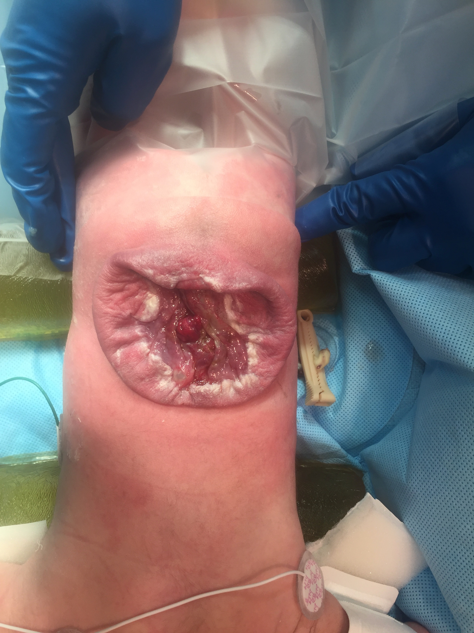
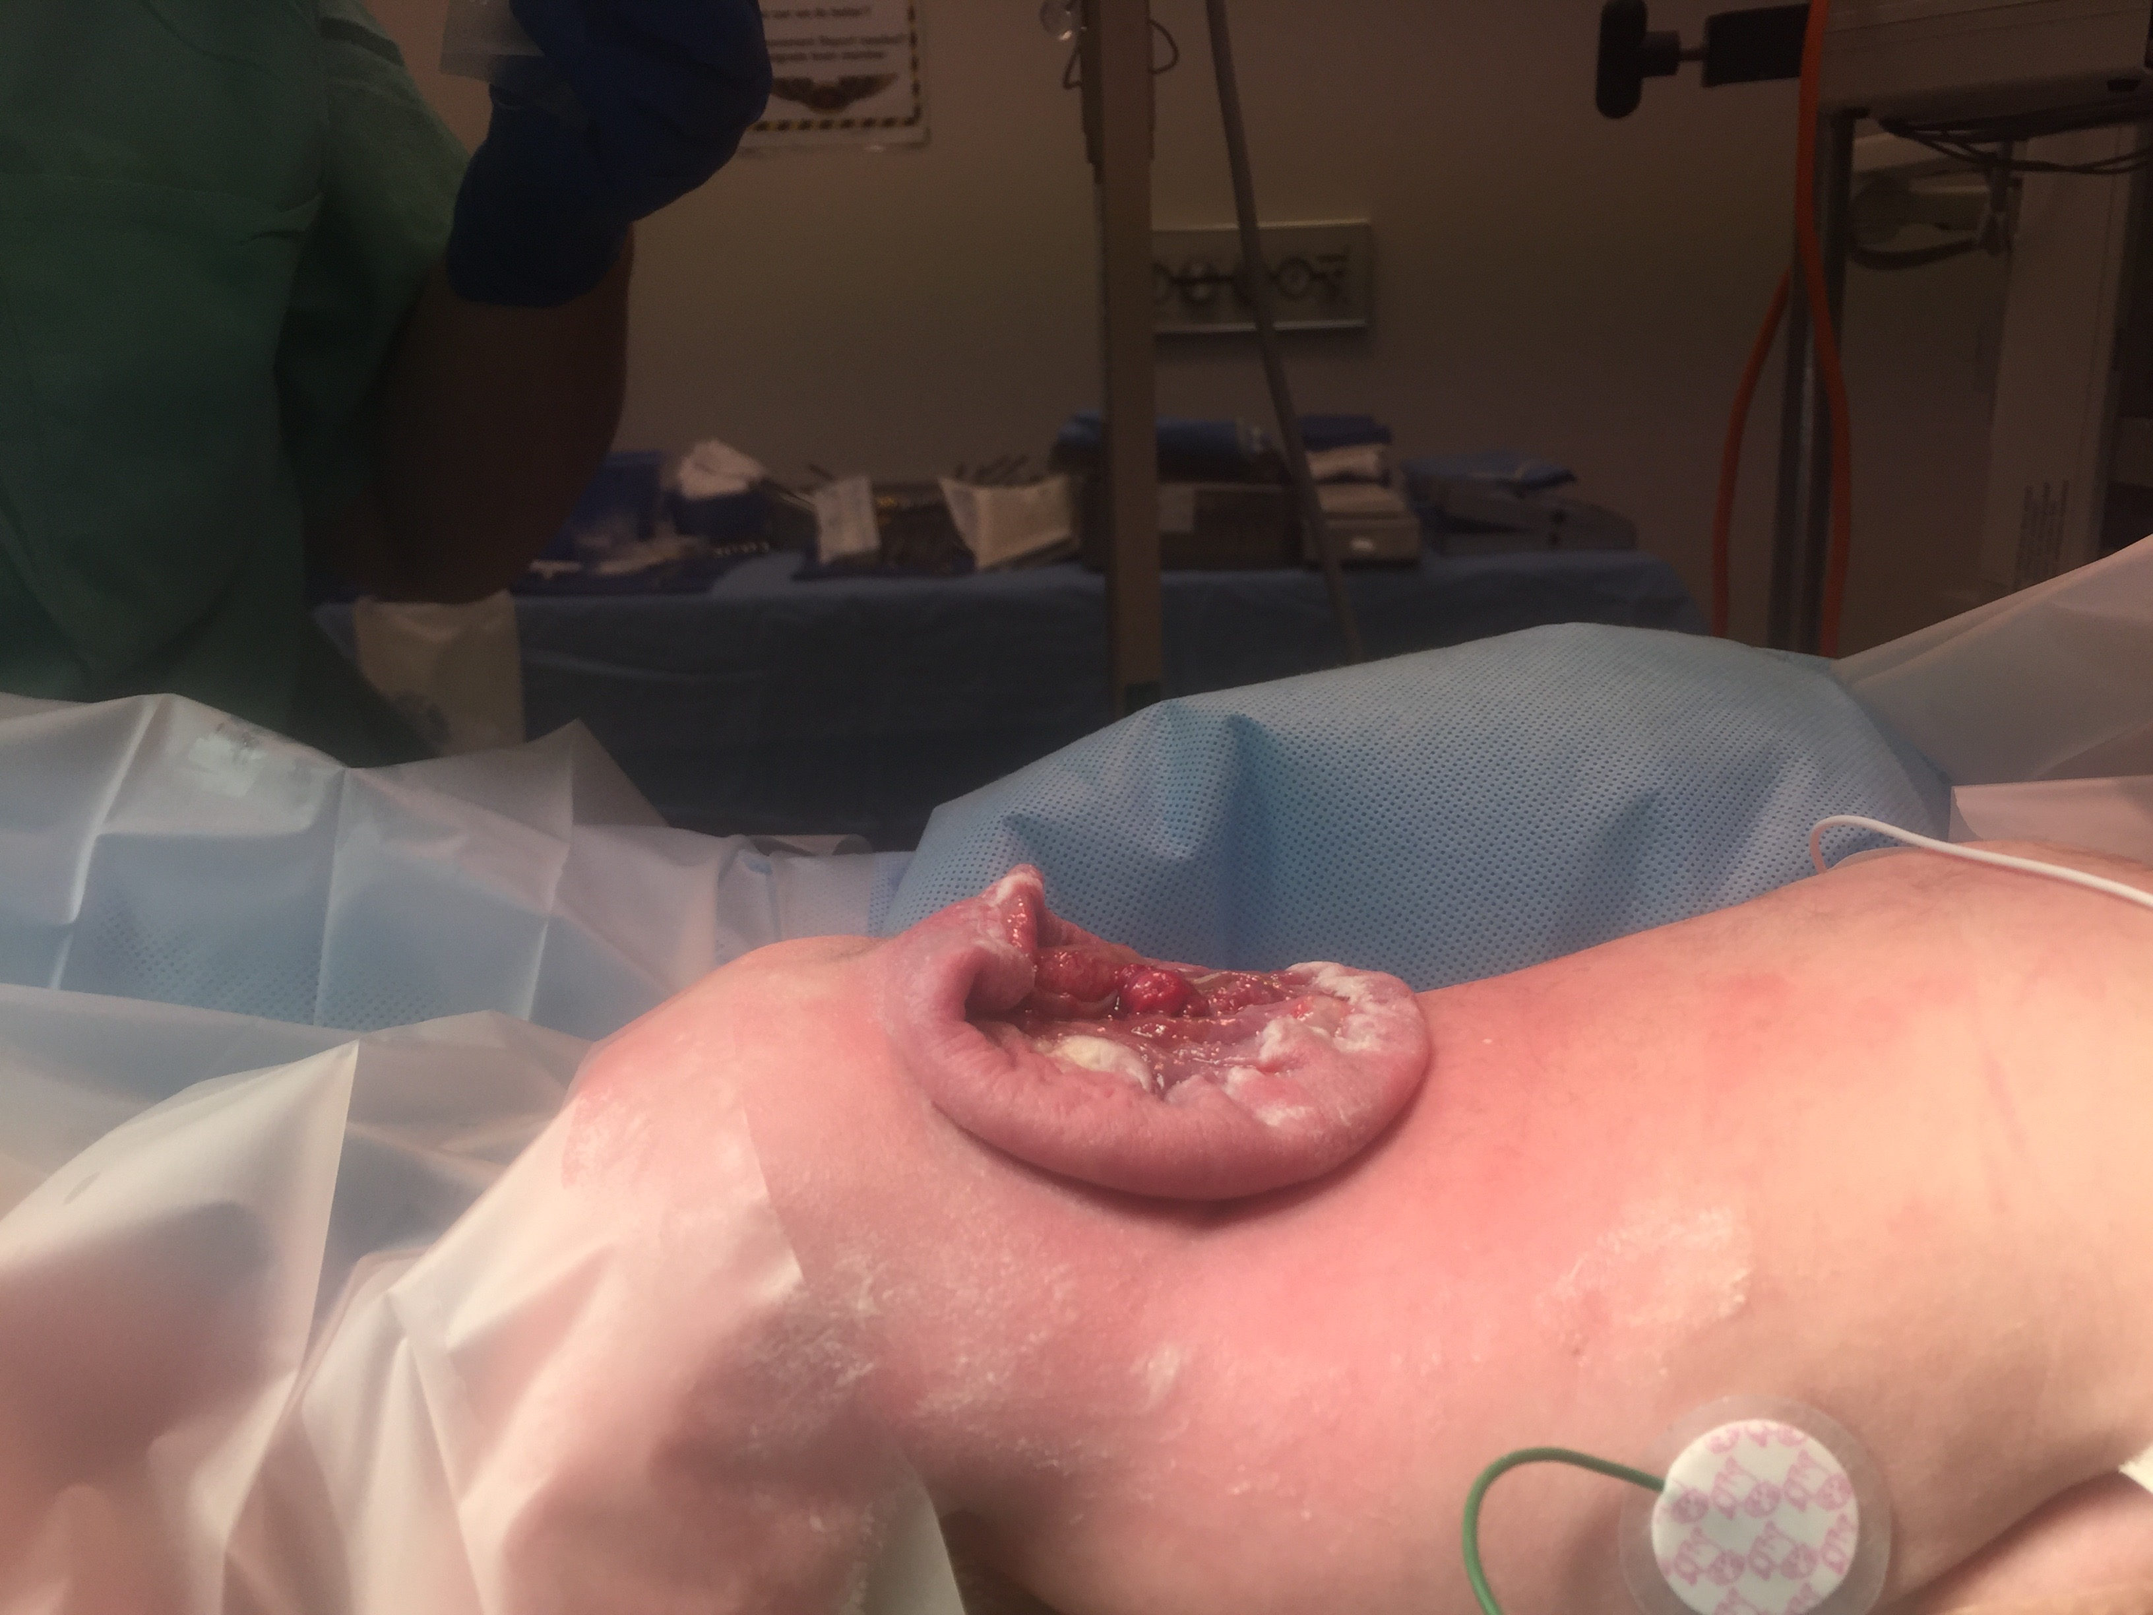
Case 1
New born with large back lesion
Notes:
EK
Pre-operative management
Moderate ventriculomegaly
Concurrent shunting and MMC repair
Complication: shunt infection Irritable and bulging fontanelle after 1 week

Slide 4
Case 2
28 year Gravida 1, Para 0 presents with fetus with L2-3 MMC detected on 18 week structural ultrasound
Mother healthy
Fetal MRI shows MMC defect. Width lateral ventricle 8 mm
Notes:
TB
Complication: premature delivery
Poor leg control post –op: observe

Slide 5
Ventricle size | Shunt rate
< 10 mm | 20%
10-15 mm | 45%
>15 mm | 79%

Slide 6
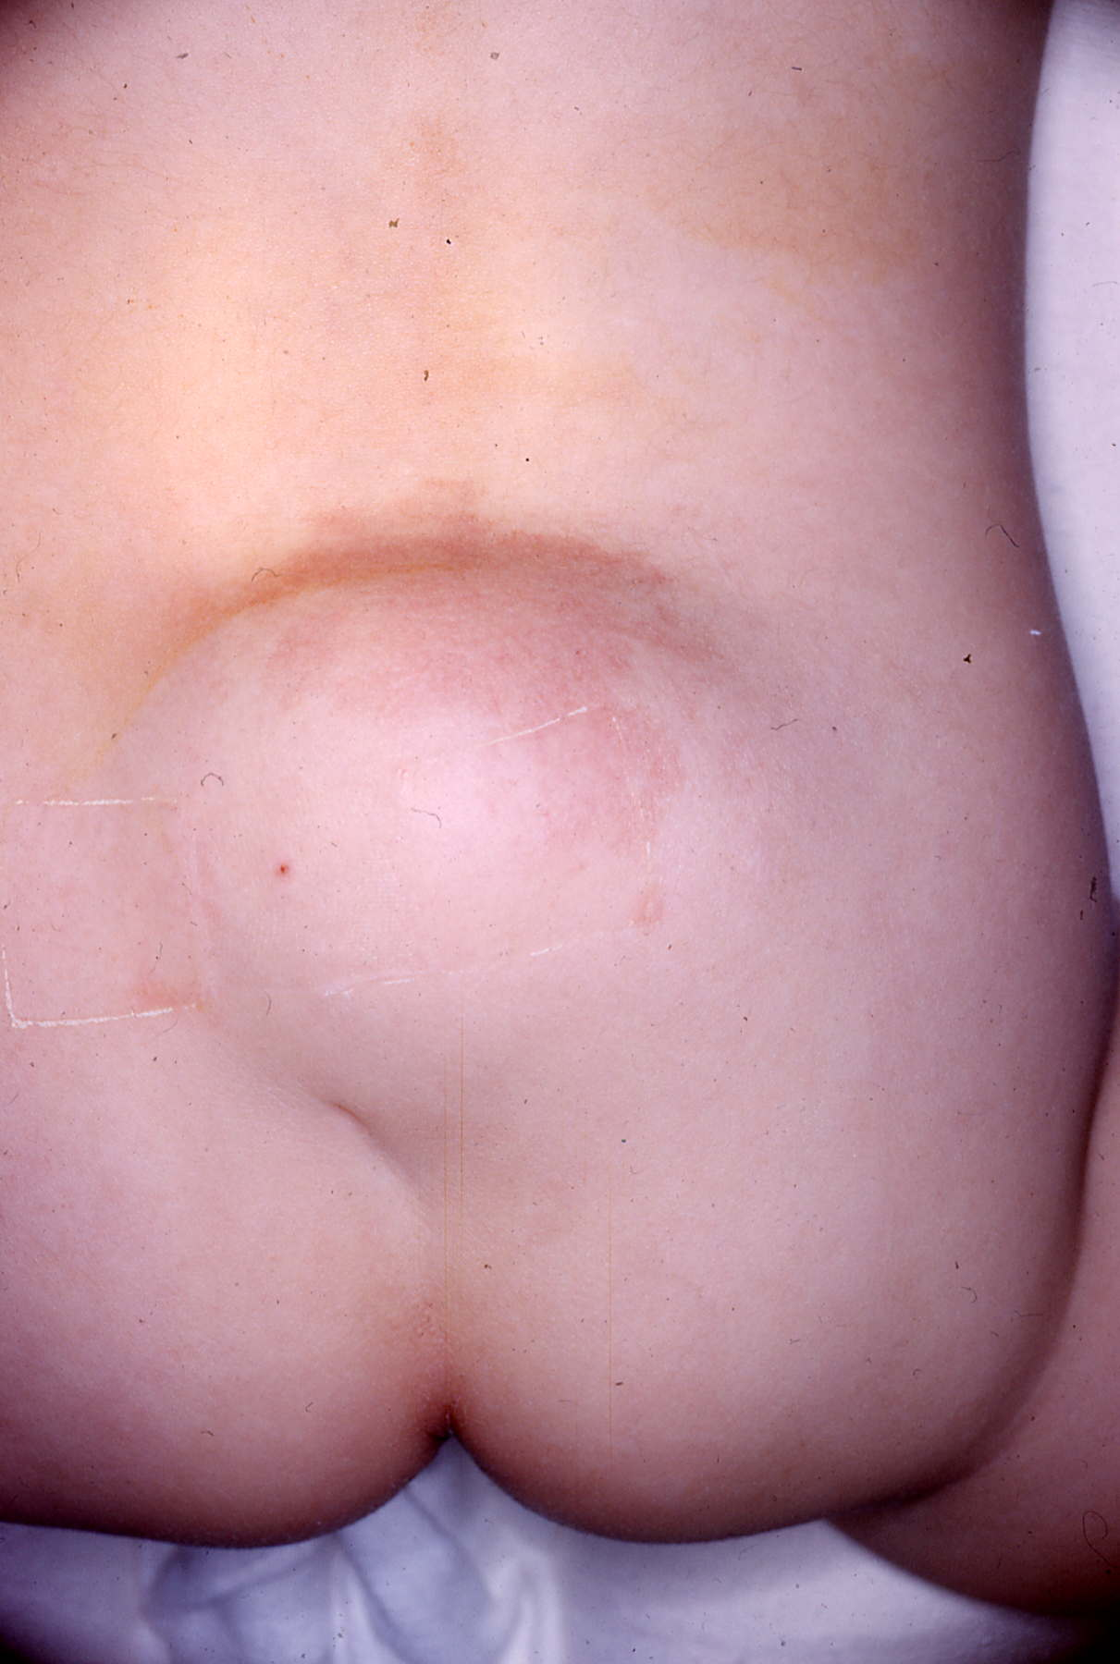
Case 3
2 month old baby with large lump on his back
Acute onset weakness in right leg 3/5
Notes:
SO
LMMC with progressive deficit aldair cuellar
Complication: CSF leak after 1 week
Complication: CSF leak after 1 week: re-exploration

Slide 7
Case 4
1 year old adopted child from China
Neurological exam normal
Notes:
AG
LMMC without symptoms
Complication: no potty training at age of 4
Follow
Complication: Not potty trained at the age of 4.5
Complication: No potty training at 4 years

Slide 8
Case 5
62 year old woman with back pain and left leg numbness
Notes:
BT
Complication: CSF hypotension headache/pseudomeningocele 1 week later

Slide 9
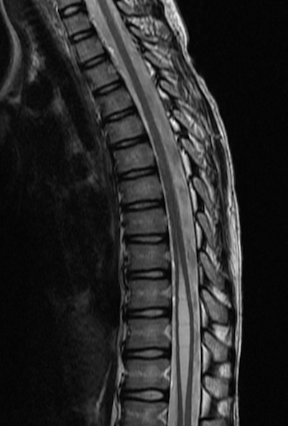
Case 6
9 year old boy with urinary incontinence
Notes:
KN
Complication: Controlling right leg

Slide 10
https://canvas.ucdavis.edu/courses/213022

