Slide 1
Complications of the treatment of hydrocephalus
Marike Zwienenberg, MD
9-17-18

Slide 2
Complications of CSF shuntiNG
Obstruction
Malposition
Infection
Disconnection/migration
Dysfunction: over/underdrainage

Slide 3
Shunt failure & complications
Shunt does not replace normal pattern of CSF clearance
Shunt obstruction is common (33% of shunts fail in 1st year, average revision time 4-5 years
Infection rate 5-10%
Shunt failure/infection major impact on patient and family

Slide 5
Case discussion
Low pressure hydrocephalic state (LL)
Shunts and headaches/SVS (DH)
Shunt malfunction in MMC patients (JA)

Slide 6
Low pressure hydrocephalus

Slide 7
Definition of lph
Symptomatic ventricular distension in a shunted patient with low ICP and proven functional CSF shunt

Slide 8
Low pressure hydrocephalus
Alteration of visco-elastic properties
Structural change in brain tissue due to prolonged overstretching
Susceptible patients (innate low brain plasticity/atrophy)
Symptoms not from pressure changes but from brain distortion
Treatment directed at restoring brain elasticity

Slide 9
The ORIGIN OF LPH
PANG & ALTSCHULER
Wrung out brain
Ventriculomegaly squeezes brain →
Shift of H₂O parenchyma to extra-cellular space →
Increased brain compliance→
AKINS ET. AL
Boggy brain
Initial event = increased brain permeability
H₂O ventricle → parenchyma
Increased brain compliance→
Ventricular dilatation→
Maintenance of ventriculomegaly at low ICP
Tx=EVD at subzero levels to bring water back in

Slide 10
The ORIGIN OF LPH
REKATE
Cranial base CSF leaks-post LP
Lack of communication between ventricles and CSAS-Development of pressure gradient
⬆︎⬆︎⬆︎⬆︎TRANS MANTLE PRESSURE (TMP) =P _{ventricle} –P_{CSAS}
⬆︎↑TMP → venous blood shift out of cranium → decrease in brain turgor →
Ventriculomegaly at low ICP
Notes:
BRAIN TURGOR:
Brain parenchyma
Blood volume
Extracellular fluid

Slide 11
Classified LPH into Spontaneous versus LP induced
Spontaneous versus LP induced
20-30% can be treated with conservative measures
LP induced LPH resolves quicker
Majority of spontaneous pts s/p RTX/chemo

Slide 12
Notes:
Adult patients: autonomic dysregulation (brainstorming)
Supraventricular tachyarythmias (4th Ventricle enlargement)

Slide 13
Treatment of LP-LPH (n=11)
(27%) Conservative measures:
-cervical wrap
-enforced recumbency
-serial shunt tapping
-valve dial down
(36%) Intermediate measures
Lumbar blood patch +/- externalization
(37%) Immediate shunt externalization
Resolution in +/- 3 days (2-13)
Post-externalization Tx:
33% internalization same valve
33% internalization different valve
33% other (shunt removal, ETV, different terminus (pleural space)

Slide 14
Treatment of spontaneous LPH (n=19)
26% terminal patients (died within 1 month of LPH diagnosis)
Treated patients:
(14%) conservative measures
(78%) externalization
(7%) valve revision
Mean drainage time: 9 days (2-90)
Post externalization Tx:
54% shunt no valve change
27% shunt valve change
18% pleural/atrial terminus for shunt

Slide 15
Review of treatment options
TMP =P _{ventricle} -P_{CSAS}
Cervical wrap
Enforced recumbency
Valve dial down
Serial shunt tapping/pumping
Blood patch/skull base repair
Shunt externalization
Valve revision
VA or pleural shunt

Slide 16
Hydrocephalus and headaches
”Slit ventricle syndrome”

Slide 17
Typical patient
First shunt at young age
Longstanding history of chronic severe headaches
Multiple shunt evaluations and interventions
Small ventricles on imaging
Minimal to no change on serial imaging

Slide 18
5 clinical scenarios (rekate)
Shunt overdrainage /CSF hypotension
Intermittent proximal shunt obstruction (true SVS)
Normal volume hydrocephalus/shunt pseudotumor
Cephalocranial disproportion
Shunt related migraines

Slide 19
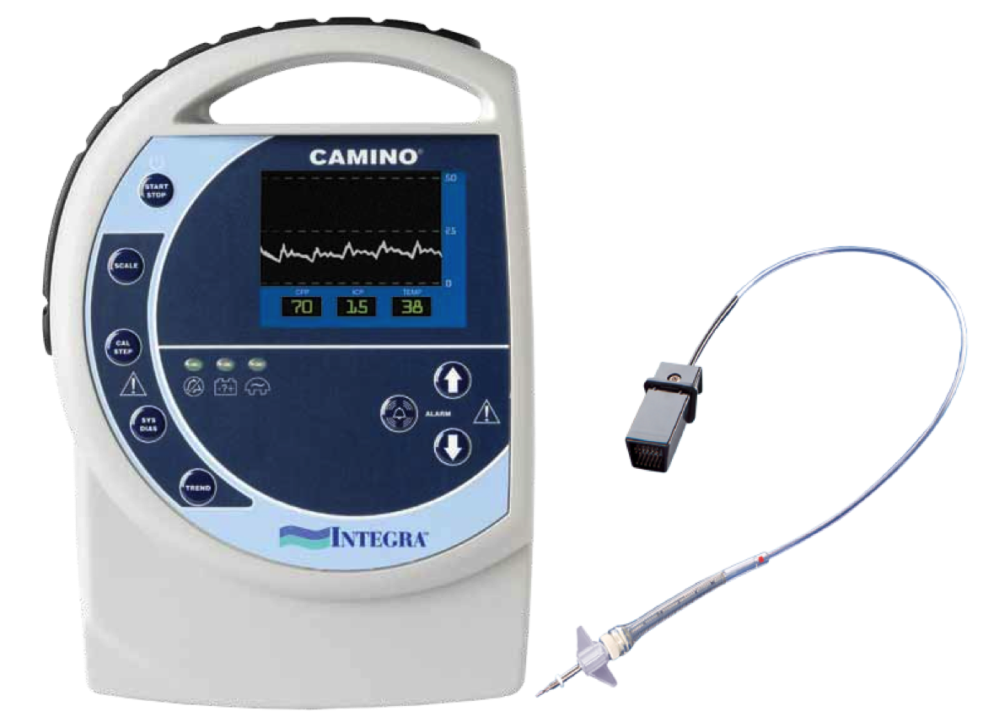
ICP monitoring protocol
48 hour hospital admission
ICP monitoring protocol:
Day 1 Monitor insertion/free activity
Overnight sleep data
Day 2 Mobilize to sitting/upright
Overnight sleep data prn

Slide 20
5 clinical scenarios (rekate)
Shunt overdrainage/CSF hypotension
Intermittent proximal shunt obstruction (true SVS)
Normal volume hydrocephalus/shunt pseudotumor
Cephalocranial disproportion
Shunt related migraines
Negative ICP when erect
Intermittent ICP spikes with recovery
Chronically severely elevated ICP
(Crouzon/Pfeiffer): plateau waves at night
Normal ICP

Slide 21
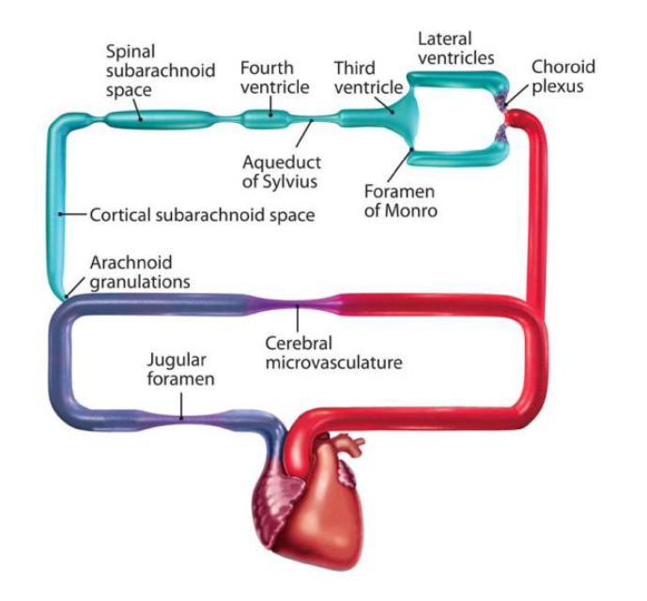
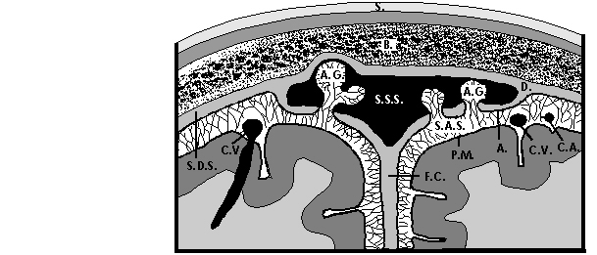

Slide 22
Notes:
Protocol for patients not responding to valve change

Slide 23
NVH/Shunt pseudotumor
Most difficult to understand and difficult to treat
Unique to infantile hydrocephalus/spina bifida
Underlying etiology similar to pseudotumor cerebri
↑ sagittal sinus pressure (P atrium↑ or venous outflow obstruction)
DEFINED AS: Severely increased ICP without ventricular dilation
Notes:
(achondroplasia)

Slide 24
NVH/Shunt pseudotumor
Free communication between ventricles and CSAS
Venous outflow impaired
Untreated HCP: high ICP drives CSF outflow through venous system
Sutures open → High ICP distend ventricles
After shunt insertion CSF absorption preferentially through ventricle (Shunt opening pressure below P_{ss} )
Notes:
Unlike LPH communication is free

Slide 25
NVH/Shunt pseudotumor
Ventricles collapse around shunt catheter/ Shift of septum pellucidum occludes Monroe
High venous pressure has remained: CSAS pressure ↑
Ventricles remain small and ICP is high:
TMP = ↑ P _{ventricle} – ↑ P_{CSAS}

Slide 26
Treatment options
1. Addition of ASD
01
II LP SHUNT
02
III CM-to ventricle shunt (Spina bifida/achondroplasia)
03

Slide 27
spina bifida and syringomyelia

Slide 28
2 year old status post-natal closure of MMC Presents with increasing filling pressures of bladder and right foot in turning

Slide 29
19 MO OLD S/P PRENATAL MMC REPAIR PRESENTS WITH PROGRESSIVE BILATERAL FOOT CLUBBING
Oct 2017
July 2018

